Slide 1
The Rhetoric of the Op-Ed Page: Ethos, Logos, and Pathos Developed by John R. Edlund
Mrs. Curran
Taken from CSU ERWC Binder
B114/ Oxnard High School

Slide 2
Reading Selections for this Module
Braithwaite, Victoria. “Hooked on a Myth: Do Fish Feel Pain?” Los Angeles Times 8 Oct. 2006: M5. Print.
Edlund, John R. “Letters to the Editor in Response to ‘A Change of Heart About Animals.’” 2003 Print.
Edlund, John R. “Three Ways to Persuade.” 2011. Print.
Rifkin, Jeremy. “A Change of Heart About Animals.” Editorial. Los Angeles Times 1 Sept. 2003: B15. Print.
Yong, Ed. “Of Primates and Personhood: Will According Rights and ‘Dignity’ to Nonhuman Organisms Halt Research?” Seed. Seed Magazine, 12 Dec. 2008. Web. 24 Jul. 2012.

Slide 3
Text—“Three Ways to Persuade”
Reading Rhetorically
Prereading
Activity 1: Getting Ready to Read
Consider the title and the subheads in the article “Three Ways to Persuade” by John R. Edlund. What is this article about? What do the three terms “ethos,” “logos,” and “pathos” mean? Now read the whole article, thinking briefly about the discussion questions at the end of each section. When you finish the article, engage in the option assigned by your teacher.

Slide 4
Option 1: Quickwrite
Think of something you tried to persuade a parent, teacher, or friend to do or believe. It might have been to buy or pay for something, to change a due date or a grade, to change a rule or decision, to go somewhere, or some other issue. What kinds of arguments did you use? Did you use logic? Did you use evidence to support your request? Did you try to present your own character in a way that would make your case more believable? Did you try to engage the emotions of your audience? Write a short description of your efforts to persuade your audience in this case.

Slide 5
Activity 2: Exploring Key Concepts
For each term, answer the following questions:
What does this term mean to you?
Should we use the Greek word, or is there an English word that means exactly the same thing?
Look at the discussion questions for each section. Are Aristotle’s three terms relevant to your own writing?

Slide 6
Term | What it Means to You
Ethos
Pathos
Logos

Slide 7
Okay, in case you are still confused, here’s a video that cleared it up for me:
http://www.youtube.com/watch?v=bHMQEggEG4k

Slide 8
Option 2: Skit
In a small group, discuss the strategies your friends use when they are trying to borrow a car, go to a concert, buy new clothes, or achieve some other desired result. Pick a situation, and write a short skit showing those persuasive strategies in action. Each skit should employ logical, emotional, and ethical persuasion. Rehearse and perform your skit for the class.
After you have completed the option assigned, discuss the following questions:
Do people use Aristotle’s concepts of ethos, logos, and pathos every day without thinking about it? Can you think of some examples?
Do these concepts apply to politics and advertising as well as person-to-person persuasion? Can you think of some examples?
Are there other means of persuasion that Aristotle did not discuss?

Slide 9
Activity 3: Exploring the Concept of “Persuasion”

Slide 10
The article is called “Three Ways to Persuade.” Aristotle says that the art of rhetoric is the art of “finding the available means of persuasion.” What does it mean to persuade someone? Is it the same as “convince”? In the dialogue called Gorgias, Plato has the famous sophist (or rhetorician) Gorgias define rhetoric as “the art of persuasion in courts of law and other assemblies about the just and unjust.” Plato then has Socrates ask Gorgias, “Which sort of persuasion does rhetoric create in courts of law and other assemblies about the just and unjust, the sort of persuasion which gives belief without knowledge or that which gives knowledge?”
Gorgias answers, “Clearly, Socrates, that which only gives belief.” This exchange leads to some important philosophical questions:
What is the difference between “knowledge” and “belief”?
One way of thinking about this is to take a current controversial event such as a murder, a scandal, a celebrity divorce, or other prominent news item and fill out a box with four quadrants labeled like this:

Slide 11
In case you can’t think of a topic

Slide 12
What I know | How I know it
What I believe | Why I believe it

Slide 13
Is “proving” different from “persuading”? Does proving lead to knowledge, while persuading leads to belief? How do we “prove” that something is true? Are there some notions that we believe strongly, even though we can’t prove them?
What is the difference between what is certain and what is probable? If, as in a courtroom, the jury decides that something has been proved “beyond a reasonable doubt,” does that mean that it is certainly true or merely highly probable? Are we persuaded only by what is certain or sometimes by what is probable, in that it is likely to be true, or that most people would agree that it is true?
In the dialogue mentioned above, Gorgias says that rhetoric is about the “just and unjust.” How would you distinguish a “just” action from an “unjust” action? (The word “just” here is related to the word “justice.”)

Slide 14
Text—“A Change of Heart About Animals”
Activity 4: Surveying the Text
Look at the article “A Change of Heart About Animals” by Jeremy Rifkin. Think about the following questions:
Where and when was this article published?
Who wrote the article? Do you know anything about this writer? (Hint: Look at the end of the article.) How could you find out more?
What is the subtitle of the article? What does that tell you about what the article might say?
The article was published on the editorial page. What does that mean?

Slide 15
Activity 5: Making Predictions and Asking Questions (Rifkin)
As you look at the text of “A Change of Heart about Animals,” answer and then discuss the following questions:
What does it mean to have “a change of heart”?
What are some common ideas or feelings people have about animals?
What kinds of experiences might cause someone to change his or her ideas or feelings about animals?
What are some groups of people who have strong feelings about how animals are treated? What do you know about them? What do they usually believe?

Slide 16
What is a vegetarian or a vegan? Do you know anyone who is a vegetarian? What does he or she think about eating animals? (Most students are familiar with these practices.)
What do you know about the author? Do you think he might be a vegetarian?
Read the first sentence of the article. It mentions breakthroughs in biotechnology and nanotechnology. Do you think this article is about those things? Why or why not?
This article appeared in a newspaper. What does that mean about the audience? Is this an article for scientists?
What do you think is the purpose of this article? Does the writer want readers to change their minds about something?
Will the article be negative or positive in relation to the topic? Why?
What argument about the topic might it present? What makes you think so?
Turn the title into a question (or questions) to answer after you have read the text.

Slide 17
Activity 6: Understanding Key Vocabulary
When you read “A Change of Heart about Animals,” you will need to know the following terms to understand the text:
humane and inhumane
cognitive
genetically wired
empathy
Think about words that you know that sound similar to these words and may be related. For example, “humane” is related to “human,” and “empathy” is related to the Greek word “pathos” in “Three Ways to Persuade.”
Create a word tree based on the root of a word from the text or one listed above. Here is an example of a word tree for “cognitive.”

Slide 18
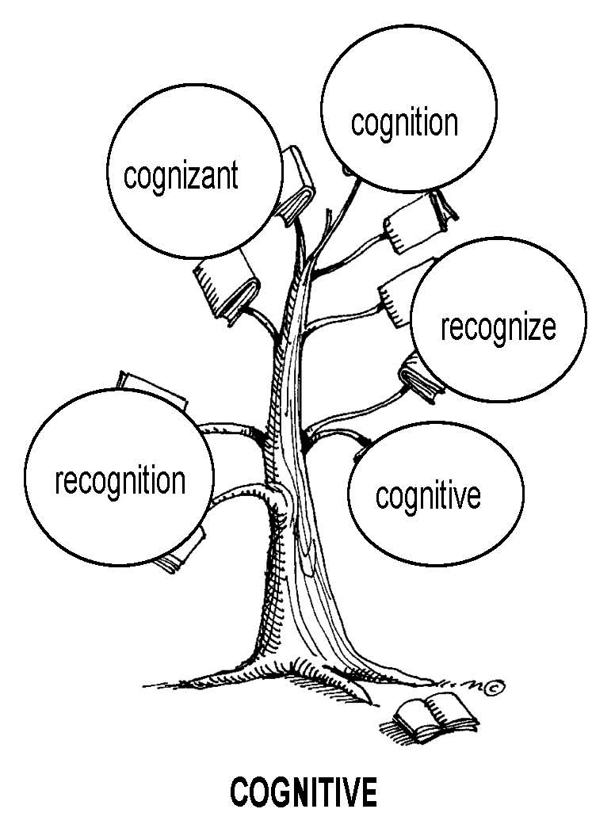

Slide 19
Reading
Activity 7: Reading for Understanding
Now you are ready to read Jeremy Rifkin’s “A Change of Heart about Animals.” For the first time through, you should read to understand the text. Read as if you trust Rifkin, and focus on what he is trying to say. Try to see whether the predictions you have made about the text are true. Is the article about what you thought it would be about? Does Rifkin say what you thought he would say?
When you have finished reading, answer the following questions:
Which predictions turned out to be true?
What surprised you?
What does Rifkin want readers to believe?
What are some of the things people believe humans can do that animals cannot? How does Rifkin challenge those beliefs?
What authorities does Rifkin use to support his case?
What action does Rifkin want readers to take?
How does Rifkin organize his essay? Is it an effective organization?

Slide 20
Activity 8: Considering the Structure of the Text
Now that you have read and discussed the content of the Rifkin essay, you are ready to begin analyzing its organizational structure. First, divide the text into sections:
Draw a line across the page where the introduction ends. Is the line after the first paragraph, or are there more introductory paragraphs?
Divide the body of the essay into sections on the basis of the topics addressed.
Draw a line where the conclusion begins. Is it the last paragraph, or does it begin before that?

Slide 21
You are now ready to begin a process called “descriptive outlining”:
Write brief statements describing the rhetorical function and content of each paragraph or section.
What does each section do for the reader? What is the writer trying to accomplish?
What does each section say? What is the content?
After making the descriptive outline, ask questions about the article’s organizational structure:
Which section is the most developed?
Which section is the least developed? Does it need more development?
Which section is the most persuasive? The least?
From your work charting the text, what do you think is the essay’s main argument? Is it explicit, or is it implicit?

Slide 22
Activity 9: Noticing Language
Create a visual representation of “your” word, study its origin or history, and be prepared to share it (and its synonyms and antonyms) with the class. You might choose to construct a tree, chart, or table from Activity 6.

Slide 23
Activity 10: Annotating and Questioning the Text
You should question the text in your second reading, “reading against the grain” and “playing the disbelieving (or doubting) game.” As you read, look for claims and assertions Rifkin makes. Does he back them up? Do you agree with them?
As you read, do the following:
Underline (with a double underline) or highlight in one color the thesis and major claims or assertions made in the article.
Underline (with a single underline) or highlight in a second color the evidence in support of the claims and assertions.
Write your comments and questions in the margins.

Slide 24
After reading the article again, answer the following questions:
What is the thesis of Rifkin’s article?
Does Rifkin make any claims that you disagree with? What are they?
Do any claims lack support?

Slide 25
Activity 11: Analyzing Stylistic Choices—Loaded Words: Language That
Puts a Slant on Reality
Paragraph 4 of the article says
Studies on pigs’ social behavior funded by McDonald’s at Purdue University, for example, have found that they crave affection and are easily depressed if isolated or denied playtime with each other. The lack of mental and physical stimuli can result in deterioration of health.
The first sentence uses words associated with human behavior such as “affection” and “playtime,” while the second sentence uses formal scientific words such as “stimuli” and “deterioration.” What is the effect of this movement from emotional to scientific? Try rewriting the first sentence to make it sound more scientific.

Slide 26
Paragraph 7 of the article says
Researchers were stunned recently by findings (published in the journal Science) on the conceptual abilities of New Caledonian crows. Because scientific experiments are carefully planned and controlled, scientists are rarely “stunned” by their results.
What is the effect of using the word “stunned” here? What are some other words or phrases that might fit here that would sound more scientific? Try rewriting this sentence.

Slide 27
Paragraph 10 of the article says
An orangutan named Chantek who lives at the Atlanta Zoo used a mirror to groom his teeth and adjust his sunglasses.
“Groom” is a word that has different meanings when applied to humans and animals. If animals groom each other, it usually means that one cleans the other’s fur or searches the fur to remove fleas and other parasites. It is part of social bonding. If a human grooms a horse, it means combing and brushing the animal. What does “groom” mean when applied to humans? In what sense is the word used here? Rewrite the sentence using other language to make it more scientific.

Slide 28
Activity 12: Questions About the Rifkin Article
Answer the following questions about the Rifkin article:
How would you describe the style of this article? Is it formal? Informal? Academic? Scientific? Conversational?
What is the effect of giving the names of most of the animals involved in the experiments but not the names of the scientists?
Throughout most of the article, Rifkin refers to “researchers” and “scientists.” In paragraph 13, however, he directly quotes Stephen M. Siviy, whom he refers to as “a behavioral scientist at Gettysburg College in Pennsylvania.” What is the effect of this sudden specificity?
What is the effect of all the rhetorical questions in paragraph 15, followed by “such questions are being raised” in the next paragraph?

Slide 29
Postreading
Activity 13: Summarizing and Responding
Summarizing the ideas of others accurately is a fundamental element of academic writing. Summarizing is a powerful metacognitive skill that enables readers and writers to synthesize a text’s meaning. It integrates the results of previous reading processes students have engaged in and helps them further understand major ideas and the relationships among them.
Some options summarizing the Rifkin article are the following:
Use the annotations you made from the left margins and/or the descriptive outlining activity to construct a summary using your knowledge of the author’s structure of the text.
Work in groups to summarize a main part of the text. Then create with the entire class a coherent paragraph that summarizes all the main points of the text.

Slide 30
Responding gives you the opportunity to articulate your personal reactions to the text. Possible ways to respond to the text are the following:
Revisit the reflections you made in the right margin when you annotated the text, and write a paragraph based on your experiences and opinions.
Write open-ended questions that can be used as the basis for a class discussion

Slide 31
Responding gives you the opportunity to articulate your personal reactions to the text. Possible ways to respond to the text are the following:
Revisit the reflections you made in the right margin when you annotated the text, and write a paragraph based on your experiences and opinions.
Write open-ended questions that can be used as the basis for a class discussion

Slide 32
Activity 14: Thinking Critically
At this point, the concepts of ethos, logos, and pathos come back into play. From the analysis you have done so far, you should be well prepared to analyze the logic and support of the arguments, the character and intentions of the author, and the emotional effects on the reader of the language used and the details provided.

Slide 33
Questions about the Writer (Ethos)
Who is Rifkin? If you have not done so already, do an Internet search to find out something about him. What is his profession? What does he usually write about? Does everybody agree with him? Do the facts you find about his life, his credentials, and his interests make him more credible to you? Less credible?
Pick one of the studies Rifkin mentions, and try to find out more. Is Rifkin’s description of the study accurate?
Does Rifkin have the right background to speak with authority on this subject?
What does the author’s style and language tell you about him?
Do you trust this author? Do you think this author is deceptive? Why or why not?

Slide 34
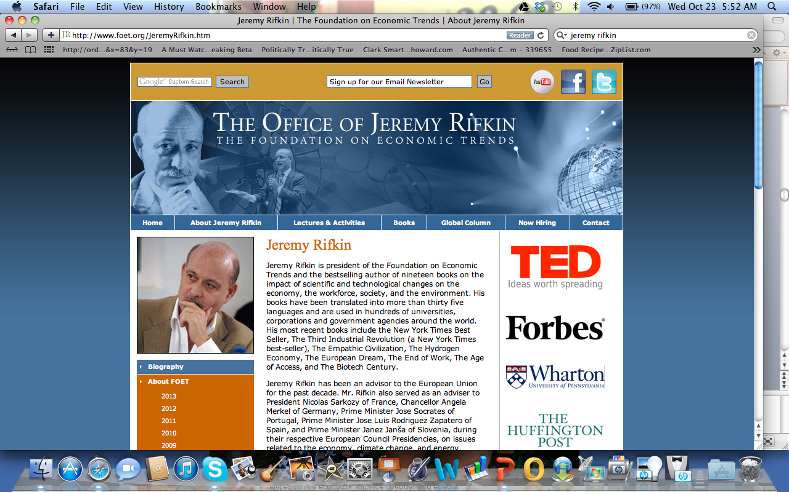

Slide 35
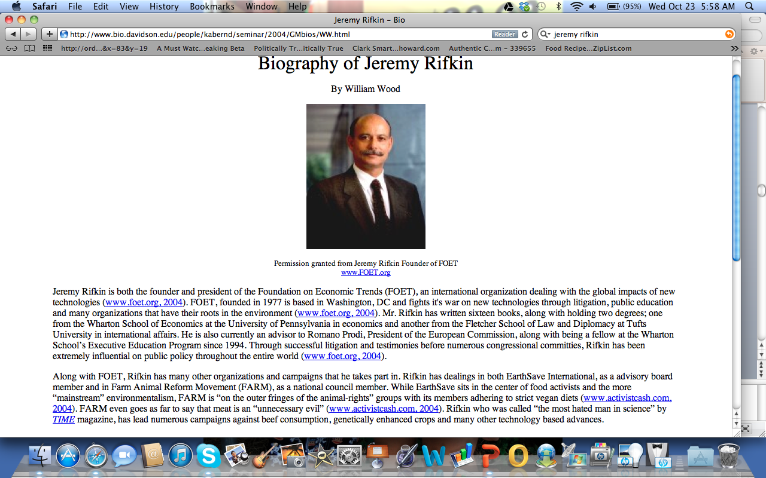

Slide 36
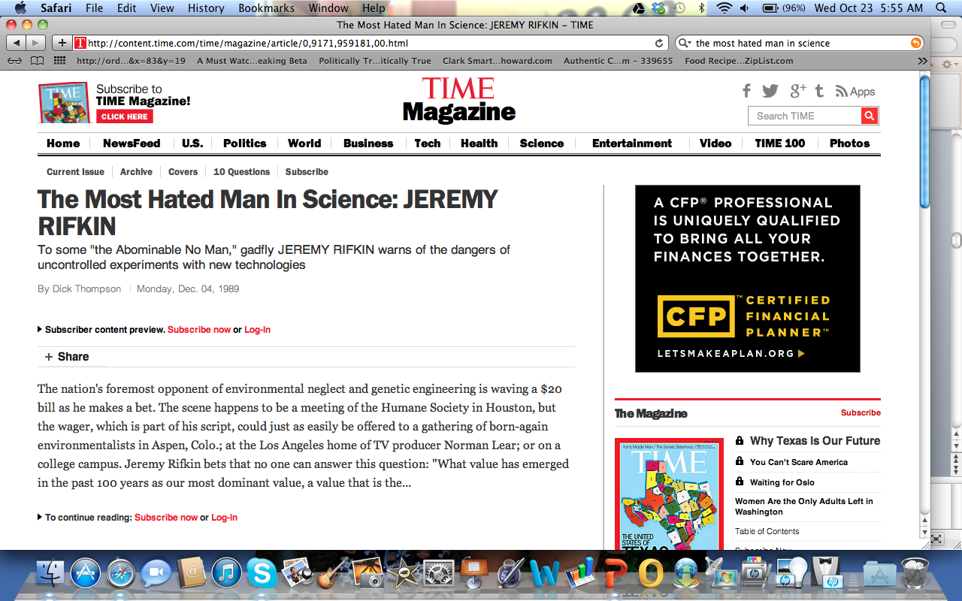

Slide 37
Questions about Logic (Logos)
Locate major claims and assertions you have identified in your previous analysis and ask yourself: Do I agree with Rifkin’s claim that …?
Look at support for major claims and ask yourself: Is there any claim that appears to be weak or unsupported? Which one and why?
Can you think of counterarguments that the author does not deal with?
Do you think Rifkin has left something out on purpose? Why or why not?

Slide 38
Questions about Emotions (Pathos)
Rifkin says that Germany is encouraging farmers to give pigs human contact and toys. Does this fact have an emotional impact on the reader? If so, what triggers it? What are some other passages that have an emotional effect?
Rifkin calls his essay “A Change of Heart about Animals.” Does this imply that the scientific discoveries he summarizes here should change how we feel about animals?
Does this piece affect you emotionally? Which parts?
Do you think Rifkin is trying to manipulate your emotions? How?
Do your emotions conflict with your logical interpretation of the arguments? In what ways?

Slide 39
Text—“Hooked on a Myth: Do Fish Feel Pain?”
Prereading
Activity 15: Surveying the Text (Braithwaite)
The following questions, applied to the Rifkin article above, are equally relevant here:
Where and when was this article published?
Who wrote the article? Do you know anything about this writer? (Hint: Look at the beginning of the article.) How could you find out more? Is this writer more or less credible than Jeremy Rifkin?
What is title of the article? The subtitle? What do these words tell you about what the article might say? Can you make some predictions?

Slide 40
Activity 16: Understanding Key Vocabulary
Look at this list before reading the article. Because the article is written for non-scientists, it defines many of these words in the text.
nociceptors (¶ 3): nerve endings that detect damage and cause feelings of pain
trigeminal nerve (¶ 3): the main nerve for the face in all vertebrates
vertebrates (¶ 3): animals with a spine
A-delta and C fibers (¶ 3): types of nociceptors
noxious (¶ 5): harmful, poisonous or unpleasant

Slide 41
adverse behavior (¶ 5): contrary, harmful or unfavorable
mammalian (¶ 12): an adjective describing animals that have breasts and nurse their young
amygdala (¶ 12): part of the brain associated with emotions
hippocampus (¶ 12): part of the brain associated with memories
automata (¶ 13): a self-operating machine
crustacean (¶ 17): an animal with an exoskeleton such as a crab, shrimp, or lobster

Slide 42
Reading
Activity 17: Reading for Understanding (Braithwaite)
Before reading the Braithwaite article, discuss the following questions:
Have you ever gone fishing? Did you catch a fish? What did the fish do? How did it behave? Did you eat it?
What other experiences have you had with live fish? Do you have an aquarium at home? Have you been to a public aquarium? What did you learn from these experiences?
From your experiences, do you think that fish feel pain? Why or why not?

Slide 43
Activity 18: Considering the Structure of the Text—Descriptive Outline
Do a descriptive outline of the Braithwaite text.
Are we justified in treating fish differently from other animals?

Slide 44
Activity 19: Analyzing Stylistic Choices
Answer the following questions about the Braithwaite text:
What is the effect of the use of scientific terms in an article that is written for newspaper readers?
Do these terms confuse the reader?
Do they make the writer more credible?
Do they help the reader understand the type of argument being made?

Slide 45
Postreading
Activity 20
Summarizing and Responding—Quickwrite
Summarize the article in your own words, answering the following questions:
Why does Victoria Braithwaite think that we should treat fish more like the way we treat other animals, such as birds and mammals? Do you agree? Why or why not?

Slide 46
Text—“Of Primates and Personhood: Will According Rights and
‘Dignity’ to Nonhuman Organisms Halt Research?”
Reading
Activity 21: Reading for Understanding
Discuss the first part of the title, “From Primates to Personhood.”
Have you ever seen gorillas, chimpanzees, bonobos (which are sometimes called “pygmy chimpanzees”) or orangutans, all of which are considered to be “great apes,” at a zoo? In what ways are they like humans? In what ways are they different?
Most of us know people who treat their pets like people. What does this mean? What types of behavior characterize these pet owners?
Do great apes deserve to be treated like people? Why or why not?
If apes had “personhood,” would it still be okay to keep them in zoos?

Slide 47
Activity 22: Noticing Language—Vocabulary
Below are lists of words and phrases from the Yong article that you might not know (or might be confused about), some that are related conceptually to the module’s key concept, and some that are technical.
1. primates (title): apes and monkeys
2. primatologists (¶ 1): scientists who study primates.
3. schism (¶ 1): a split
4. great apes (¶ 1): humans, chimpanzees, bonobos (pygmy chimpanzees) and orangutans
5. unprecedented (¶ 1): without precedent; never happened before

Slide 48
6. domain (¶ 1): a territory one rules or controls
7. implement (¶ 3): put into effect
8. ventures (¶ 3): businesses or projects
9. captivity (¶ 3): a state of being held captive; to be captured or imprisoned
10. obligations (¶ 4): duties; requirements
11. compelling (¶ 4): “compelling reasons” are reasons that are so forceful and important that they cannot be ignored
12. salvo (¶ 6): a volley of gunfire; in this case, the gunfire is metaphorical and the word refers to opening arguments or legal moves
13. traction (¶ 6): a tire with traction sticks to the road and can move forward; in this case the “traction” is political: people are buying the argument and making changes.8.

Slide 49
14. sanctuary (¶ 7): a safe place
15. inroads (¶ 8): advances into defended territory
16. invasive (¶ 8): something that invades across a boundary, such as a border, or the skin
17. rigorously (¶ 8): done with great care and precision
18. paragon (¶ 9): a person or thing that is a perfect example of something, or a high point in excellence
19. unaligned (¶ 9): independent, not part of a group or faction

Slide 50
20. dignity (¶ 9): a state of respect and status
21. interventions (¶ 9): literally to “come between”; acts by an outsider that interfere or change an ongoing process or relationship
22. humiliation (¶ 9): from “humility,” the state of being humble; to reduce the dignity of an individual
23. disproportionately (¶ 9): out of proportion; unequal or unfair
24. instrumentalized (¶ 9): made into a tool or object
25. decapitation (¶ 10): behead; cut off the head

Slide 51
26. impermissible (¶ 10): not permitted or allowed
27. preliminary (¶ 10): at the beginning; before the actual start
28. macaques (¶ 11): a type of monkey
29. advisory (¶ 11): giving advice, not orders
30.clinical (¶ 11): related to medical practice
31. termination (¶ 12): ending
32. enamored (¶ 13): in love with
33. obligation (¶ 14): duty; required action

Slide 52
Activity 23: Analyzing Stylistic Choices—Representing Relationships and
Positions
Words and phrases can be used to position ideas in relationship to each other. These distinctions might be according to time, location, degree, or other types of differences. In your group, for each phrase below, discuss how the language positions the ideas that follow it in relation to other ideas.
At the forefront of the battle … (¶ 2)
Other countries … have taken steps … (¶ 3)
Not everyone is comfortable … (¶ 4)
Speaking personally … (¶ 5)

Slide 53
In the US, there is greater resistance … (¶ 8)
Weaker than its Spanish counterpart, the bill … (¶ 8)
In the EU [European Union], renowned chimpanzee researcher Jane Goodall has called … (¶ 9)
A discussion paper … defines … (¶ 10)
In the US, Edwin McConkey, a biologist … agrees that … (¶ 12)
One kind of primate experiment seems to be safe …(¶ 13)

Slide 54
Postreading
Activity 24: Summarizing and Responding—Quickwrite
Summarize the Yong article in your own words, answering the following questions:
What is the event or events related to animal rights that motivate Ed Yong to write this article? What questions does Yong raise about this issue? What positions do people take on these questions?

Slide 55
Activity 25: Thinking Critically—Defining “Personhood”
In paragraph 7, Yong discusses the case of Hiasl (pronounced Hee- sel), a former research chimpanzee who is going to be homeless because his sanctuary is going bankrupt. It is clear from the article that Hiasl’s fate depends on how we define “person.” Can Hiasl be declared a person with rights? Answer the following questions:
1. What exactly is Hiasl?
2. What qualities does Hiasl have that would make us call him a person? What qualities does he have that would make us call him something else? (You might want to make a chart.)
3. Is Hiasl a person?

Slide 56
4. What should we do about Hiasl?
5. Does Hiasl’s plight have potential as an appeal to pathos?
6. Does Yong use it for this purpose?
7. Is Yong entirely objective?

Slide 57
Activity 26: Reflecting on Your Reading Process
Answer the following questions:
What problems did you have reading these texts?
What strategies helped you overcome these problems?
Do you think these strategies will work with other readings?

Slide 58
Connecting Reading to Writing
Discovering What You Think
Activity 27: Considering the Writing Task—Letter to the Editor
A common way to respond to an editorial is to write a letter to the editor. Now that you have worked extensively with this text, you are ready to write a well-informed response to Rifkin’s or Braithwaite’s ideas.

Slide 59
Some points to note before writing your letter to the editor follow:
A good letter to the editor is focused and concise. It should make your point, but no words should be wasted. It is sometimes best to write a longer draft and then cut out everything that is not essential.
Newspaper editors often cut letters to fit the available space or to make a letter more focused. If your letter is published unedited, you are very lucky.
Some letters respond to the thesis of the editorial, either in support or disagreement, and provide further arguments or further evidence. Other letters focus on one point made by the original author and support it, question it, or refute it.

Slide 60
These days, most letters are emailed to the newspaper. To get a letter published in a major newspaper, you must write it quickly and send it within a day or two of the publication date of the editorial to which you are responding.
If the newspaper wants to publish your letter, you will normally receive a call or an email to get permission and to verify that you really are who you say you are.
Newspapers are interested in a wide range of viewpoints from diverse citizens. If your letter is a good expression of a particular viewpoint, brings up new information or arguments, or has some particularly good phrases, it has a good chance of being published.

Slide 61
Choose one of the Letter-to-the-Editor assignments below.
Response to Rifkin
After thinking about your reading, discussion, and analysis of Rifkin’s article and the letters in response to it, what do you personally think about Rifkin’s point? Do you think it is true, as Rifkin says, that “many of our fellow creatures are more like us than we had ever imagined”? Do you think we need to change the way we treat the animals around us? Or do you think Rifkin is wrong? Write a letter expressing your viewpoint to the editor of the newspaper.

Slide 62
Response to Braithwaite
Victoria Braithwaite argues that fish have nervous systems that are similar to humans and are very likely to feel pain the way we do. She says, “We should adopt a precautionary ethical approach and assume that in the absence of evidence to the contrary, fish suffer.” She also says, “Of course, this doesn’t mean that we necessarily must change our behavior. One could reasonably adopt a utilitarian cost-benefit approach and argue that the benefits of sportfishing, both financial and recreational, may outweigh the ethical costs of the likely suffering of fish.”
Should we ban the use of barbed hooks? Should we change our fishing practices because fish might suffer? Or is Braithwaite making a big deal out of nothing? Write a letter expressing your viewpoint to the editor of the newspaper.

Slide 63
Activity 28: Considering the Writing Task—Essay Assignment
An organization called the Animal Legal Defense Fund has sponsored a petition that calls for increased protection for the rights of animals. It says the following:
Deprived of legal protection, animals are defenseless against exploitation and abuse by humans. Through the Animal Bill of Rights, the Animal Legal Defense Fund is working to show Congress a groundswell of support for legislation that protects animals and recognizes that, like all sentient beings, animals are entitled to basic legal rights in our society.

Slide 64
The petition calls for the right of all animals to be free from exploitation, cruelty, neglect, and abuse and enumerates further rights for laboratory animals, farm animals, companion animals, and wildlife.
Do you think animals need a “Bill of Rights”? Would such a law go against centuries of human culture? Would it increase the cost of food? Would it hinder medical research? Would it cause other problems? Write a well-organized essay explaining the extent to which you agree or disagree with the idea of creating a Bill of Rights for animals. Develop your points by giving reasons, examples, or both from your own experience, observations, and reading.
Note: The entire petition can be seen at http://org2. democracyinaction.org/o/5154/p/dia/action/public/?action_KEY=5078

Slide 65
Activity 29: Taking a Stance—Letter to the Editor
Before you write your own letter in response to Rifkin, look at the two sample letters to the editor written in response to “A Change of Heart about Animals.” Then discuss the following questions:
Bob Stevens disagrees with Rifkin and makes several points. Does Stevens refute Rifkin’s arguments?
In his first paragraph, Stevens argues that because a predator (such as a hawk) does not feel empathy for its prey, humans do not need to feel empathy for the animals they eat and that such feelings would be unnatural. Do you agree?

Slide 66
Stevens notes that some animals can mimic human speech but argues that they do not understand what they are saying. What would Rifkin say to this?
Is it true, as Stevens argues, that Rifkin wants animals to have more rights than humans?
Lois Frazier says that pet owners know that animals have feelings and abilities not too different from humans. Do some pet owners treat their pets like people? Is this a good move? Why or why not?
Frazier argues that Rifkin needs to take his argument further and promote a vegetarian lifestyle with no animal products. Is this a reasonable conclusion to draw from Rifkin’s arguments? Do you agree with her?

Slide 67
Activity 30: Taking a Stance (Animal Bill of Rights)
After reading and discussing the essay assignment, review your collected notes and annotations to see how they are relevant to the prompt. Then answer the following questions:
Would Rifkin agree with the supporters of the Animal Bill of Rights? Do you agree?
Would Braithwaite agree? Do you agree with her?
If you agree with the authors of the readings, do you agree completely? (We are often tempted to say, “I totally agree with…” when in fact, we don’t agree totally. We agree with some points but not others.)
What would be the consequences of the position you take? Sometimes we find that while we find an abstract philosophical position attractive, we are unwilling to accept the practical consequences of the position. For example, what if the Animal Bill of Rights meant that you couldn’t eat meat anymore? What if it made fishing illegal? What if it told you how to take care of your dog?
Can you state your position in a sentence or two?

Slide 68
Activity 31: Trying on Words, Perspectives, and Ideas
One way to practice looking at the situation from multiple perspectives is to engage in an activity in which different personas are adopted. First, adopt a persona or perspective based on criteria from your teacher. The perspectives could be based on the writers of the articles you have been reading or sources quoted in them, but they could also be based on other people you know or know of, such as a teacher, the school principal, the President of the United States, or even a movie actor or a rock star. Then, answer the following questions based on the issues raised by the articles you have been reading.

Slide 69
These could be policy questions:
(What should we do about ?)
or value questions
(Is good or bad?).
Your task is to think,
“What would say about this?”
“How would answer this question?”

Slide 70
Activity 32: Gathering Evidence to Support Your Claims
What are you going to quote or paraphrase from the article or articles you read? What do you want to say in response?
What information do you need to support your claims? Where are you going to find it? (This may involve Internet searches. If so, what search terms will you use?)
How closely does this piece of evidence relate to the claim it is supposed to support?

Slide 71
Is this piece of evidence a fact or an opinion? Is it an example?
If this evidence is a fact, what kind of fact is it (statistic, experimental result, quotation)?
If it is an opinion, what makes the opinion credible?
What makes this evidence persuasive?
How well will the evidence suit the audience and the rhetorical purpose of the piece?

Slide 72
Activity 33: Quote, Paraphrase, and Respond
Choose three passages from the article you might be able to use in a letter or an essay. You may want to choose passages you strongly agree or disagree with.
First, write each passage down as a correctly punctuated direct quotation.
Second, paraphrase the material in your own words. What does the author mean by this?
Third, respond to the idea expressed in the passage by agreeing or disagreeing with it and explaining why.

Slide 73
Activity 34: Getting Ready to Write
At this point you should have a good idea what your stance toward the issue is and how you are going to support it. However, before you actually put pen to paper or fingers to keyboard, you may want to try some of the following steps:
Organize your notes and other materials in the order you think you will use them.
Create a rough outline of your main points. (This is usually a good idea if you are going to do a timed writing, but it also can keep you on track as you write a longer piece.)

Slide 74
Write down a statement of your position and share it with a classmate or family member. Listen to his or her response. (Examples: “No matter what Jeremy Rifkin says, humans are different from animals,” or “Current laws for the protection of animals from cruelty are adequate.”)

Slide 75
Writing Rhetorically
Entering the Conversation
Activity 35: Composing a Draft
Think about your audience. For a letter to the editor, your audience is not only the editor of the newspaper or Web site, but also the readers. For an essay about the Animal Bill of Rights, your audience is probably people who might consider signing the petition and ultimately might vote for or against it. However, in composing a first draft, your primary concern is to get your ideas down on paper and develop them. In a first draft, you can explore ideas and take risks. The first draft is sometimes called a “writer-based” draft because it is really for you, although thinking about your audience often helps you think of what to say. Later, you will revise it for your audience and proofread it. Even though you have read articles, researched facts, and engaged in discussions with your classmates and are well on your way to becoming an expert on this issue, you may actually discover some of your best ideas while writing your first draft. So go for it!

Slide 76
Activity 36: Considering Structure
Choose the appropriate model below for the type of text you are producing. Ask yourself, does your organizational pattern fit the structure? Can it be made clearer or more effective?
Letter to the Editor
As noted above, some letters respond to the thesis of the editorial, either in support or disagreement, and provide further arguments or further evidence. Other letters focus on one point made by the original author and support it, question it, or refute it. A letter to the editor will probably have a beginning, middle, and end structure something like this:

Slide 77
Introduction
In [Title of Op-Ed Piece], [Writer of Op-Ed Piece] says [Quote or Paraphrase from Op-Ed]. This is then followed by your own position statement. You may want to also indicate what role or experience you have in the matter as a way of establishing ethos.
Middle
The middle paragraph (or paragraphs) presents arguments in favor of your position. It may cite and respond to ideas from the original piece. Be concise!
Conclusion
The conclusion may make a strong final point or advocate a course of action for the reader.

Slide 78
Essay
Here are some questions that may be helpful in thinking about the effectiveness of your organization:
Introduction
Is it clear what your essay is about?
Do your readers think this is an important topic? Have you caught their interest?
Do your readers have enough background information to know why you are writing about this issue now?
Is it clear what your main point or claim about the Animal Bill of Rights will be? (Remember that you do not have to be totally for or against the Animal Bill of Rights. You might take a more nuanced position.)

Slide 79
Body
Is each point related in some way to the topic?
Are there any paragraphs that could be divided and developed further?
Do your points connect together? Are they presented in an order that is persuasive?
Have you discussed and countered the main points that a reader might raise against your position?
Do you have evidence for each point you want to make?

Slide 80
Conclusion
Is your stance toward this issue clear?
What action should your reader take about the Animal Bill of Rights?
What will happen if your reader ignores this issue?

Slide 81
Activity 37: Using the Words of Others
Using the information provided by your teacher, read your text looking for places where you have used the words and ideas of others. Have you punctuated quotations correctly? Are your paraphrases accurate and well integrated into the text? Have you documented your citations properly in the text?
Finally, prepare the Works Cited page.

Slide 82
Activity 38: Negotiating Voices
After reading the material above, re-read your paper thinking about how the different voices in your paper relate to each other. Are the relationships clear for the reader? What could you do to improve?
One way of seeing the relationships more clearly is to mark a printout of the text with different colored highlighters. Use one color for your ideas and another for each other voice in the paper. Then look at the transitions between the voices. Is it clear who is saying what? Are the relationships between the ideas clear? Does one voice dominate the piece more than others?

Slide 83
Activity 38: Negotiating Voices
After reading the material above, re-read your paper thinking about how the different voices in your paper relate to each other. Are the relationships clear for the reader? What could you do to improve?
One way of seeing the relationships more clearly is to mark a printout of the text with different colored highlighters. Use one color for your ideas and another for each other voice in the paper. Then look at the transitions between the voices. Is it clear who is saying what? Are the relationships between the ideas clear? Does one voice dominate the piece more than others?

Slide 84
Revising and Editing
Activity 39: Revising Rhetorically
At this point, we will apply critical thinking questions based on ethos, logos, and pathos similar to the ones you applied to the Rifkin article in Activity 14.
Ethos
What kind of ethos have you created for yourself in this text? Are you knowledgeable and rational? Are you passionate? Are you formal or informal? Are you sarcastic?
Are there any words or sentences that conflict with the image of yourself that you have created in the text?

Slide 85
Logos
What are your major claims?
Do you have sufficient arguments and evidence to support these claims?
Have you left any facts or issues out because they contradicted your claims? Will your reader see the gap, and figure this out?

Slide 86
Pathos
Have you included any stories, images, or observations that will affect your reader’s emotions?
Do these emotional appeals work together with your logical arguments?
Do you think that your use of emotions is an unfair manipulation of the reader? (This is a judgment call. For example, exaggerating risk to make your reader feel unreasonably afraid is probably manipulation. Reminding people of actual or probable events that would normally cause strong emotions is probably a legitimate emotional appeal.)

Slide 87
Activity 40: Considering Stylistic Choices
As you read through your draft, note any places where you remember struggling to find the right word. What other words did you consider? What features of the words did you consider? What effect do you think the different possible choices would have on readers? Why did you end up choosing the word that you did? Is there a better word?

Slide 88
Activity 40: Considering Stylistic Choices
As you read through your draft, note any places where you remember struggling to find the right word. What other words did you consider? What features of the words did you consider? What effect do you think the different possible choices would have on readers? Why did you end up choosing the word that you did? Is there a better word?

Slide 89
Activity 41: Editing the Draft
Once you are satisfied with the tone and content of your letter, you should proofread it for spelling, grammar, and punctuation errors. The following guidelines will help you edit your draft:
Editing Guidelines for Individual Work
If possible, set your essay aside for 24 hours before rereading it to find errors.
Read your essay aloud so you can hear errors and any rough spots.
At this point, focus on individual words and sentences rather than on overall meaning. Take a sheet of paper and cover everything except the line you are reading. Then touch your pencil to each word as you read.

Slide 90
With the help of your teacher, figure out your own pattern of errors—the most serious and frequent errors you make.
Look for only one type of error at a time. Then go back and look for a second type and, if necessary, a third.
Use the dictionary to check spelling and to confirm that you have chosen the right word for the context.
Use the following scoring guide to evaluate your final product.

Slide 91
Scoring Guide for Letters to the Editor
Categories
Focus
Word choice, including the use of text from the article
Argument and support, including the use of logical, emotional, and/or ethical appeals
Grammar and mechanics

Slide 92
Scoring
Score of 4—Superior
The letter is tightly focused on the issue or issues raised in the editorial, article, or opinion piece to which it responds.
The letter uses words effectively and efficiently and quotes key words and phrases from the article.
The letter makes a clear point or points and provides convincing support for those points, including logical, emotional, and/or ethical appeals.
There are no grammatical or mechanical errors.

Slide 93
Score of 3—Good
The letter focuses on an issue or issues raised in the editorial, article, or opinion piece to which it responds.
The letter uses words accurately and effectively.
The letter makes a clear point or points and provides support for those points.
Grammatical or mechanical errors, if present, are minor.

Slide 94
Score of 2—Fair
The letter discusses an issue or issues raised in the editorial, article, or opinion piece to which it responds but may be unclear or vague as to its focus.
The letter is sometimes repetitive or vague in language.
The letter does not make a clear point or does not provide support for its points.
Grammatical or mechanical errors inhibit communication.

Slide 95
Score of 1—Poor
The letter fails to clearly address an issue raised in the article.
The letter is vague, repetitive, or confusing.
The letter fails to make a clear point.
Grammatical and mechanical errors confuse and distract the reader.

Slide 96
Activity 42: Responding to Feedback
What are the main concerns readers had in reading your draft?
Do all of the readers agree?
What global changes should you consider? (thesis, arguments, evidence, organization)
What do you need to add?
What do you need to delete?
What sentence-level and stylistic problems do you need to correct?
What kinds of grammatical and usage errors do you have? How can you correct them?

Slide 97
Activity 43: Reflecting on Your Writing Process
You may want to direct reflection by asking some of the following questions:
What have you learned about your writing process?
What were some of the most important decisions you made as you wrote this text?
How did “writing about your writing” influence the way you developed your text?
In what ways have you become a better writer?

Slide 98
Congratulations! We finished our
second module of the year. Now, onto
number three…

